Slide 1

CS 527 PARALLEL COMPUTER ARCHITECTURE
Static DataFlow
Presented by :
Group 9
Mahua Singh
Kashish Aggarwal
Ishan Varshney
Sarthak Kapoor

Slide 2
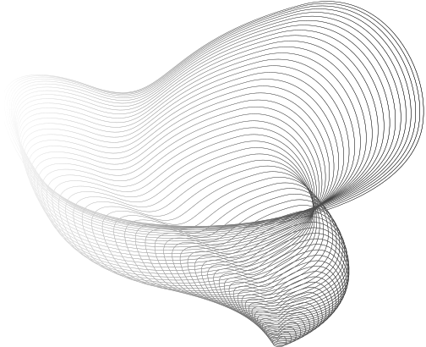
Data Flow(I)
BASICS
TRADITIONAL CONTROL FLOW
Instructions are executed in a fixed sequential order (Von Neumann model) with a program counter. Out-of-order machines do reorder execution internally, but the architecture itself is still conceptually control flow.
DATA FLOW MODEL
Instructions (nodes) are executed as soon as their input data is available. No global program counter; each operation triggers itself based on token availability. This can expose large amounts of parallelism.

Slide 3
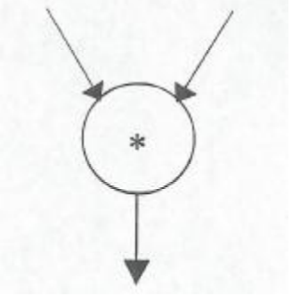
DataFlow(II)
BASICS
In a data flow machine, a program consists of data flow nodes
A data flow node fires (fetched and executed) when all its inputs are ready i.e. when all inputs have tokens
Examples of node operations include: Arithmetic (e.g.+,*,/), Logical operations (e.g., AND, OR), Higher-level functions (e.g., filters, transforms)
DATA FLOW NODE

Slide 4
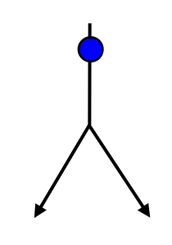
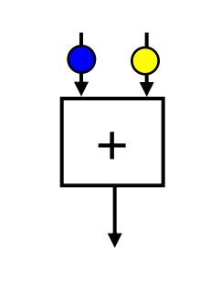
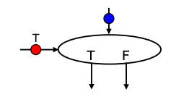
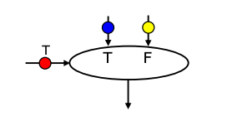
DataFlow (III)
FORK
TYPES OF NODES
OPERATORS
SWITCH
MERGE

Slide 5
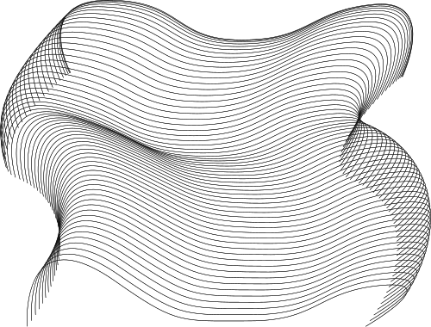
Firing
of Nodes
01
Tokens Arrive: The node’s input ports each receive the required number of tokens.
02
Execution: The node “fires” (performs its operation, such as adding two numbers).
03
Token Production: The node outputs the result as one or more tokens on its output ports.
04
Propagation: These output tokens flow along outgoing arcs to downstream nodes.

Slide 6

Graph Modelling
A data flow graph is typically represented as a directed graph G=(V,E) where:
V (vertices) are the nodes (actors/operators).
E (edges) are the arcs carrying data tokens.
Each edge (u→v) indicates that output of node u is an input to node v.
Optionally, edges can be annotated with:
Token rates (the number of tokens produced/consumed each firing).
Delays (initial tokens or placeholders that model state or pipeline stages).
In static data flow, these production/consumption rates are fixed and known at compile time, enabling a static schedule to be computed.

Slide 7
Graph Modelling
Source Node
A node with no input edges (i.e., it does not depend on any other node’s output). It might generate or provide data tokens.
Sink Node
A node with no output edges (i.e., it does not send data to any other node). It might consume tokens and produce final results for external use.

Slide 8

Deterministic Execution
Execution schedule is fixed at compile time, ensuring predictable timing. Fixed token production/consumption rates allow precise calculation of when each node fires.
Non-Reentrancy
Each node processes one set of inputs at a time, ensuring atomic and isolated operations. Prevents overlapping executions, which simplifies debugging and verification.
Low Runtime Overhead
No need for dynamic scheduling or token matching at runtime.Simplifies hardware/software implementation for real-time systems.
Ideal for Real-Time and Hardware Implementations
Suitable for hard real-time applications, FPGA/ASIC designs, and DSP systems. Fixed execution flows make it easier to meet stringent timing constraints.
Efficient Resource Utilization
Pre-determined firing order leads to efficient pipeline and parallel processing. Facilitates static allocation of resources and buffers, reducing control overhead.
Static
DataFlow
BASICS

Slide 9

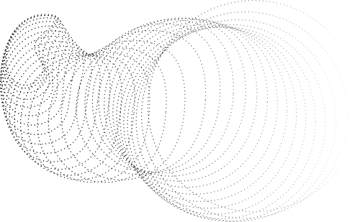
Static Dataflow
Dynamic Dataflow
Single Activation per Node: Each node in the dataflow graph can be activated only once at a time. This limits concurrency but simplifies execution
Deterministic Execution: Execution is predictable as it strictly follows predefined data dependencies
Low Overhead: Requires fewer resources as it does not need complex mechanisms for handling multiple activations or tags.
Limited Parallelism: Concurrency is restricted because simultaneous execution of multiple instances of a node is not allowed
Applications: Suitable for tasks with well-defined, static data dependencies, such as batch processing
Multiple Activations per Node: Nodes can be activated multiple times simultaneously, enabling higher concurrency.
Flexible and Adaptive: Can handle dynamic changes in data or program flow at runtime, making it more versatile.
Higher Resource Usage: Requires additional mechanisms like content-addressable memory (CAM) to manage tags and tokens for parallel execution
Enhanced Parallelism: Allows simultaneous execution of multiple instances of the same node, improving performance for parallel tasks
Applications: Ideal for scenarios with dynamic workloads, such as real-time systems and machine learning models

Slide 10
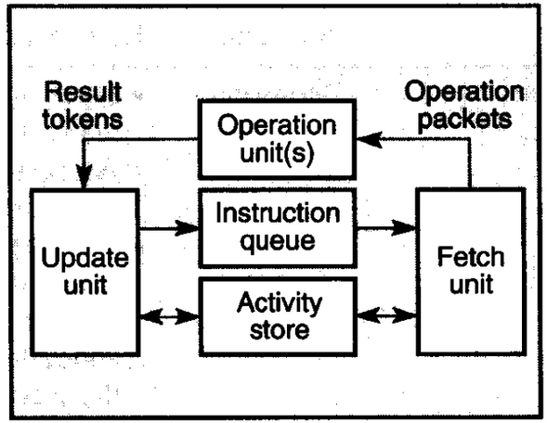
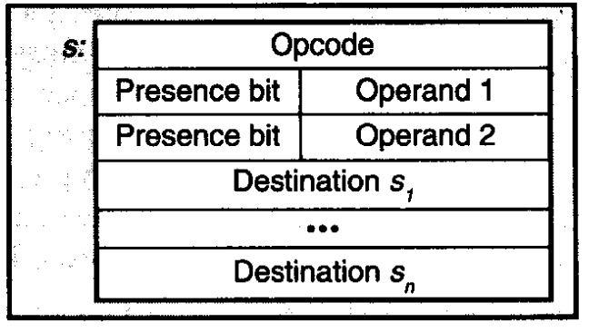
Static Dataflow Machine
Activity Store:
Contains instruction templates representing dataflow graph nodes. Each template includes an opcode, operand slots (with presence bits), and destination addresses.
Update Unit:
Monitors operand availability and flags instructions as enabled by sending their addresses via the instruction queue.
Fetch Unit:
Retrieves enabled instructions, forms complete operation packets (opcode, data, destination list), and clears presence bits.
Operation Unit:
Executes the operation, produces result tokens, and returns them to the update unit for storage and further enablement.

Slide 11
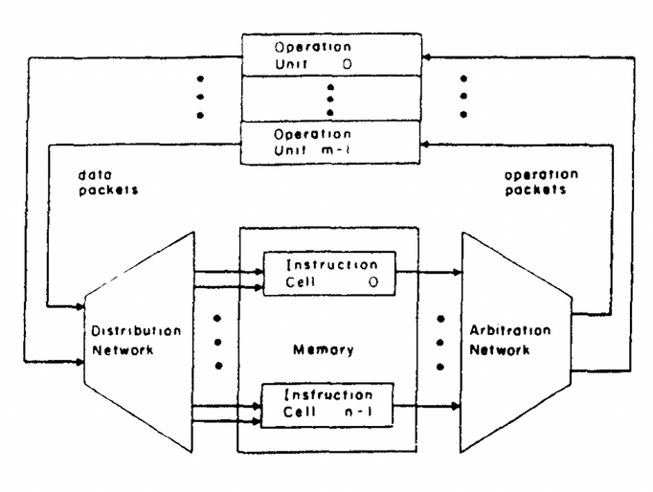
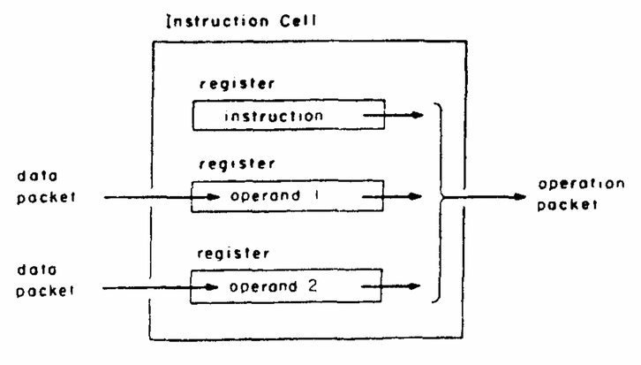
Parallelism in Static Data Flow
CONCURRENT INSTRUCTION CELLS
Multiple instruction cells (each representing a node) reside in memory and can be enabled simultaneously when their operand registers are filled.
PARALLEL RESULT DISTRIBUTION
The distribution network simultaneously routes result tokens back to destination registers, enabling rapid reactivation of instruction cells.

Slide 12
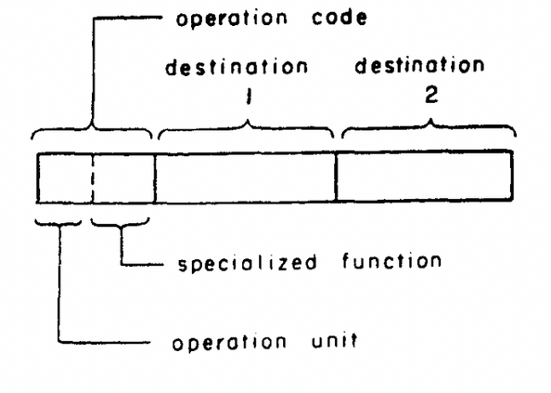
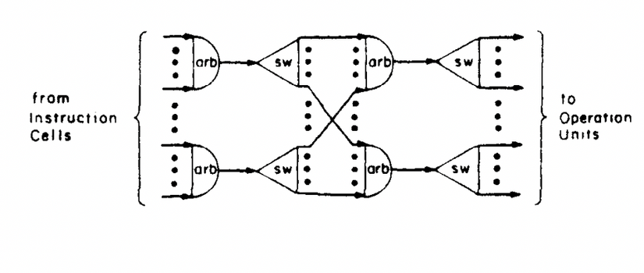
Parallelism in Static Data Flow
PIPELINED OPERATION UNITS
Operation units are pipelined so that different stages of multiple operations can be processed simultaneously, maximizing throughput.
ARBITRATION NETWORK FOR PARALLEL DISPATCH:
Operation packets from enabled cells are routed concurrently through the arbitration network to multiple operation units using techniques like round-robin scheduling.

Slide 13
2. FPGA AND ASIC HARDWARE IMPLEMENTATIONS
Custom hardware implementations (FPGAs/ASICs) require pre-determined execution flows since they lack dynamic instruction reordering.
Examples: Cryptographic Accelerators, Image Processing Pipelines, Neural Network Accelerators.
1. Hard Real-Time Systems
In real-time applications, execution times must be strictly predictable to meet deadlines. Dynamic scheduling introduces unpredictable latencies.
Examples: Avionics Systems, Medical Devices, Industrial Automation
Examples of Static Data Flow Architectures
MIT Static Data Flow Machine
Texas Instruments' Data-Driven Processor (DDP)
LAU Machine

Slide 14
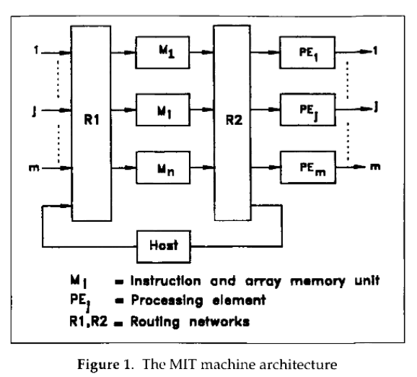
2. FPGA AND ASIC HARDWARE IMPLEMENTATIONS
Custom hardware implementations (FPGAs/ASICs) require pre-determined execution flows since they lack dynamic instruction reordering.
Examples: Cryptographic Accelerators, Image Processing Pipelines, Neural Network Accelerators.
MIT Static Data Flow Machine
1. Hard Real-Time Systems
In real-time applications, execution times must be strictly predictable to meet deadlines. Dynamic scheduling introduces unpredictable latencies.
Examples: Avionics Systems, Medical Devices, Industrial Automation
Architecture Overview:
Memory units store operations, operands, and destinations
Arbitration network manages conflicts
Distribution network routes results
Strengths:
High reliability from robust structure
Weaknesses:
Fault recovery requires full restart

Slide 15
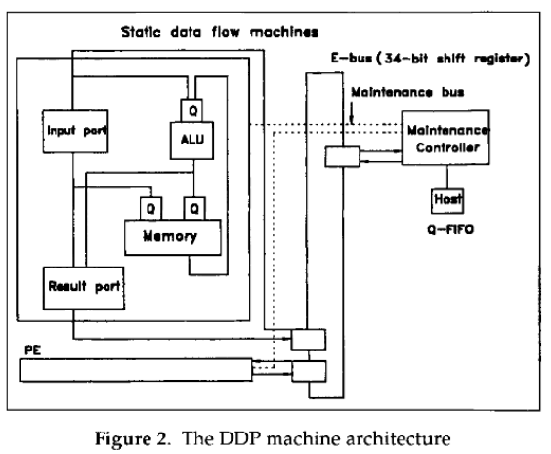
2. FPGA AND ASIC HARDWARE IMPLEMENTATIONS
Custom hardware implementations (FPGAs/ASICs) require pre-determined execution flows since they lack dynamic instruction reordering.
Examples: Cryptographic Accelerators, Image Processing Pipelines, Neural Network Accelerators.
Texas Instruments’DDP
1. Hard Real-Time Systems
In real-time applications, execution times must be strictly predictable to meet deadlines. Dynamic scheduling introduces unpredictable latencies.
Examples: Avionics Systems, Medical Devices, Industrial Automation
Architecture Overview:
Compiler generates sub-graphs
Predecessor counters track token arrivals
Pending Instruction Queue (PIQ) manages enabled nodes
Strengths:
Checkpoint-based recovery
High throughput
Weaknesses:
Moderate reliability due to checkpoint overhead

Slide 16
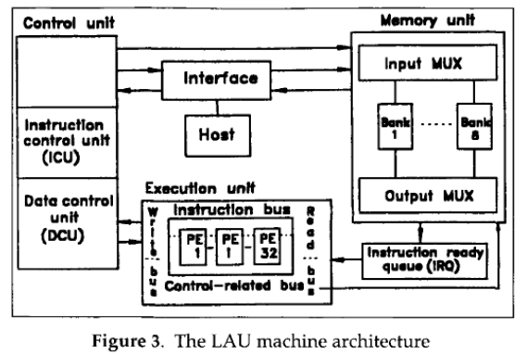
2. FPGA AND ASIC HARDWARE IMPLEMENTATIONS
Custom hardware implementations (FPGAs/ASICs) require pre-determined execution flows since they lack dynamic instruction reordering.
Examples: Cryptographic Accelerators, Image Processing Pipelines, Neural Network Accelerators.
LAU Machine
1. Hard Real-Time Systems
In real-time applications, execution times must be strictly predictable to meet deadlines. Dynamic scheduling introduces unpredictable latencies.
Examples: Avionics Systems, Medical Devices, Industrial Automation
Architecture Overview:
Instruction Control Unit (ICU) and Data Control Unit (DCU) monitor readiness
Execution unit fires enabled nodes
Interface handles communication
Strengths:
Fast fault recovery with node reassignment
Continuous operation
Weaknesses:
Lower reliability due to more moving parts

Slide 17
1. Hard Real-Time Systems
In real-time applications, execution times must be strictly predictable to meet deadlines. Dynamic scheduling introduces unpredictable latencies.
Examples: Avionics Systems, Medical Devices, Industrial Automation
Hard Real-Time Systems
In real-time applications, execution times must be strictly predictable to meet deadlines. Dynamic scheduling introduces unpredictable latencies.
Examples: Avionics
Systems, Medical Devices, Industrial Automation
Uses of Static Data Flow Architectures

Slide 18
2. FPGA AND ASIC HARDWARE IMPLEMENTATIONS
Custom hardware implementations (FPGAs/ASICs) require pre-determined execution flows since they lack dynamic instruction reordering.
Examples: Cryptographic Accelerators, Image Processing Pipelines, Neural Network Accelerators.
1. Hard Real-Time Systems
In real-time applications, execution times must be strictly predictable to meet deadlines. Dynamic scheduling introduces unpredictable latencies.
Examples: Avionics Systems, Medical Devices, Industrial Automation
Uses of Static Data Flow Architectures
FPGA and ASIC Hardware Implementations
Custom hardware implementations (FPGAs/ASICs) require pre-determined execution flows since they lack dynamic instruction reordering.
Examples: Cryptographic Accelerators, Image Processing Pipelines, Neural Network Accelerators.

Slide 19
1. Hard Real-Time Systems
In real-time applications, execution times must be strictly predictable to meet deadlines. Dynamic scheduling introduces unpredictable latencies.
Examples: Avionics Systems, Medical Devices, Industrial Automation
Compiler Optimizations (LLVM IR, Static Analysis)
Compilers must optimize code before execution using static dependency analysis to extract parallelism.
Examples: Instruction-Level Parallelism (ILP) Extraction, Loop Unrolling & Pipelining in VLIW Processors
Uses of Static Data Flow Architectures

Slide 20
Digital Signal Processing
Static data flow architectures are highly relevant to Digital Signal Processing (DSP) due to their deterministic execution, real-time constraints, and efficient parallel processing. DSP applications involve fixed, repetitive data transformations, making static data flow an ideal model for optimizing performance, power, and predictability.

Slide 21
Why Dynamic Data Flow Fails in DSP?
1. Real-time deadlines must be met → Cannot afford runtime scheduling overhead.
2. Power efficiency is critical → DSP chips use fixed execution units with minimal control logic.
3. Hardware acceleration is required → FPGAs and ASICs use fixed execution paths for performance.
4. Deterministic behavior is essential → Communications, biomedical, and safety-critical DSP applications need guaranteed response times.

Slide 22
Deterministic Execution
(Fixed Processing Pipelines)
o DSP algorithms (like FIR/IIR filtering, FFT, convolution, and modulation) require predictable execution times.
o Static data flow ensures that every operation is scheduled before execution, avoiding unpredictable latencies.
o Example: Radar Signal Processing must process echoes within a fixed time frame to detect objects in real time.

Slide 23

o DSP tasks often involve streaming data (audio, video, communications), making pipelining essential.
o Static data flow pre-allocates resources and pipelines operations efficiently without dynamic overhead.
o Example: FFT in OFDM Communication can be mapped to a static pipeline for faster execution.
Efficient Parallelism &
Pipelining

Slide 24
Hardware Optimization (FPGAs, ASICs, and DSP Processors)
o DSP algorithms are often implemented on FPGAs, ASICs, or specialized DSP processors (e.g., Texas Instruments’ TMS320, Qualcomm Hexagon).
o These architectures follow a static execution model, with predefined paths for low-power, high-speed processing.
o Example: MP3/AAC Decoding in Smartphones uses dedicated DSP units with pre-scheduled execution paths.

Slide 25
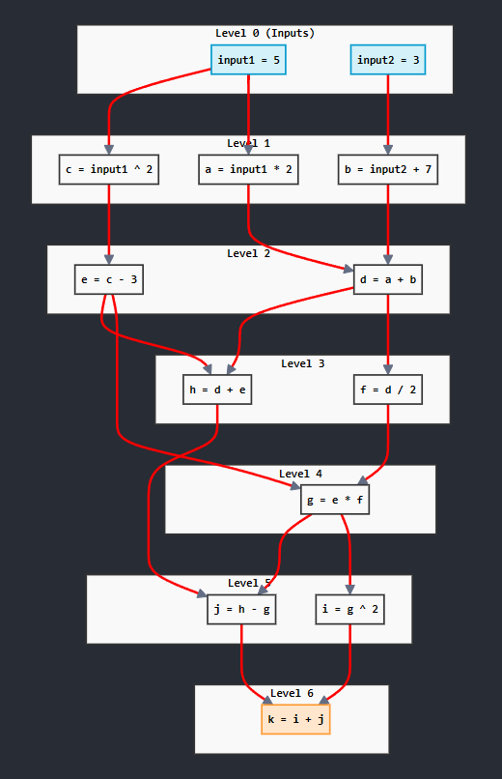
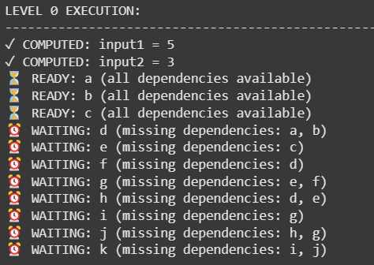
Implementation
Code: https://github.com/kashish-a/Static-Dataflow-Implmentation.git

Slide 26
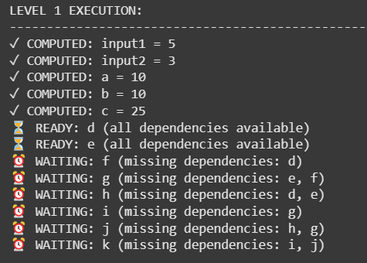
Implementation
Code: https://github.com/kashish-a/Static-Dataflow-Implmentation.git

Slide 27
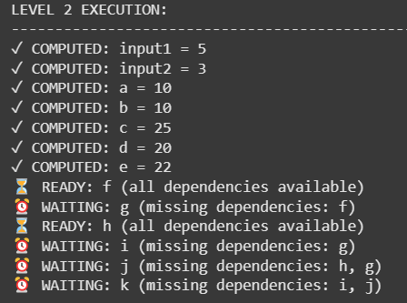
Implementation
Code: https://github.com/kashish-a/Static-Dataflow-Implmentation.git

Slide 28
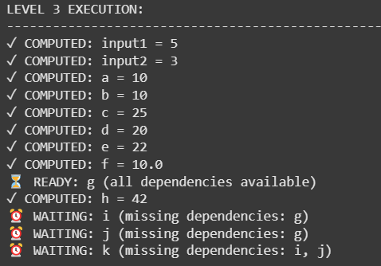
Implementation
Code: https://github.com/kashish-a/Static-Dataflow-Implmentation.git

Slide 29
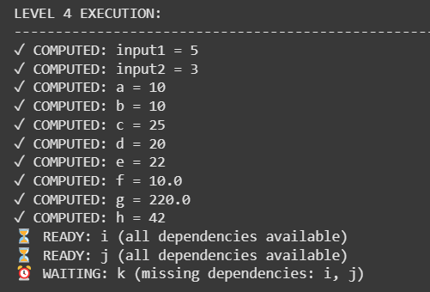
Implementation
Code: https://github.com/kashish-a/Static-Dataflow-Implmentation.git

Slide 30
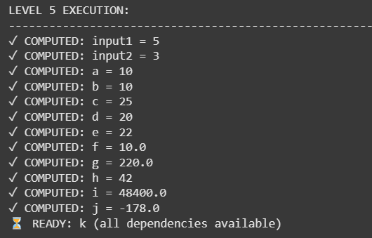
Implementation
Code: https://github.com/kashish-a/Static-Dataflow-Implmentation.git

Slide 31
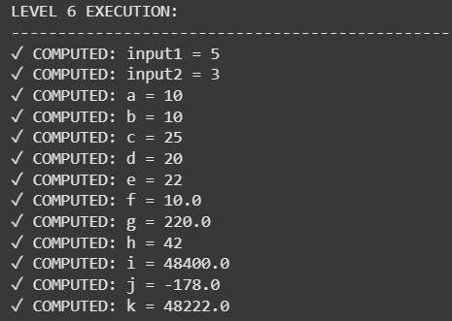
Implementation
Code: https://github.com/kashish-a/Static-Dataflow-Implmentation.git

Slide 32
References
https://pages.cs.wisc.edu/~markhill/restricted/ieeecomputer94_dataflow.pdf
https:/course.ece.cmu.edu/~ece742/f12/lib/exe/fetch.php?media=onur-18-742-fall12-lecture22-dataflow-i-afterlecture.pdf
https://courses.cs.washington.edu/courses/cse548/11au/Dennis-Dataflow.pdf
https://journals.sagepub.com/doi/10.1177/003754979907300203

Slide 33
Conclusion
Static data flow architectures are crucial for modern computing, enabling efficient parallelism, energy efficiency, and real-time guarantees. They are widely used in ML accelerators, HPC, embedded systems, and network processors, making them a key component of the latest computing advancements.

Slide 34

Thank you!
Please ask us your questions
and comments.

